Slide 1
ITCS 6162 – Project Group 12
Ayanjyoti Thakuria
Sai Kumar Thallada
Narendra Kumar Vankayala
Mohit Varma
Sathyaram Venkatesan

Slide 2
Definition of Action Rules
An action rule is a rule extracted from an information system that describes a possible transition of objects from one state to another with respect to a distinguished attribute called a decision attribute
Action rules can be constructed from certain parts of classification rules, but the construction turns out to be expensive
Action rules can be seen as logical terms, describing, knowledge about possible actions associated with objects which are hidden in a decision system

Slide 3
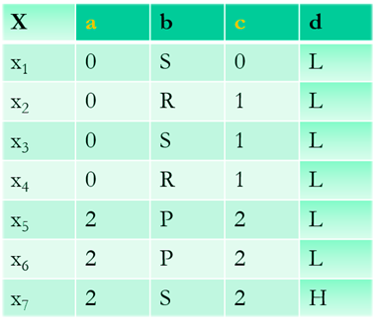
Example of Action Rules
{a, c} - stable attributes,
{b, d} - flexible attributes,
d - decision attribute.
Rules discovered:
r1 = [(b, P) à (d, L)]
r2 = [(a, 2) Ù (b, S) à (d, H)]
Action rule:
[(a, 2) Ù (b, P® S)](x) Þ[(d, L® H)](x)

Slide 4


Project Process
Pre – Processing steps
Mammographic Mass Dataset:
We replaced special characters like question marks to 1
We have implemented the action rules code using Java and created the GUI.

Slide 5

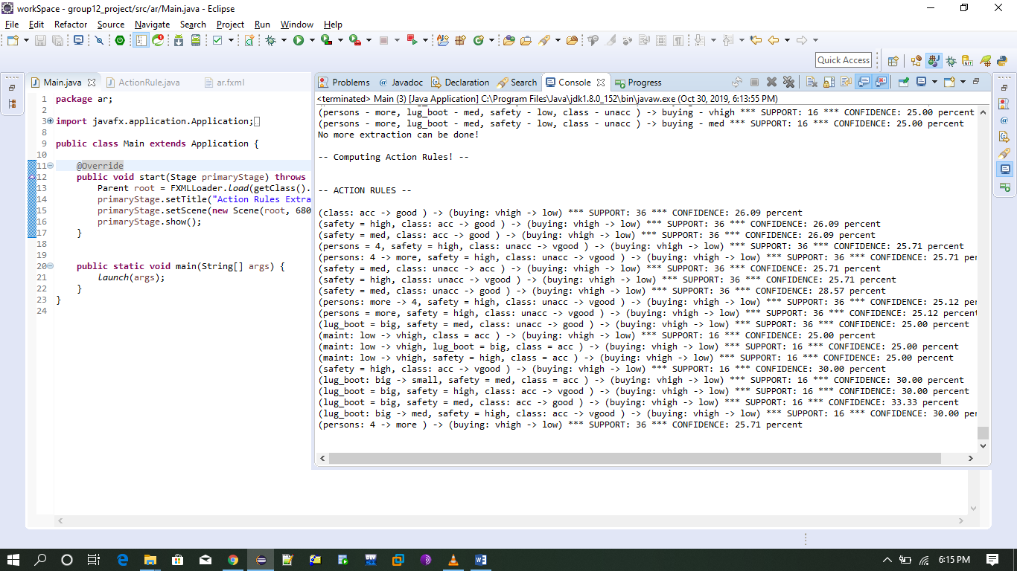
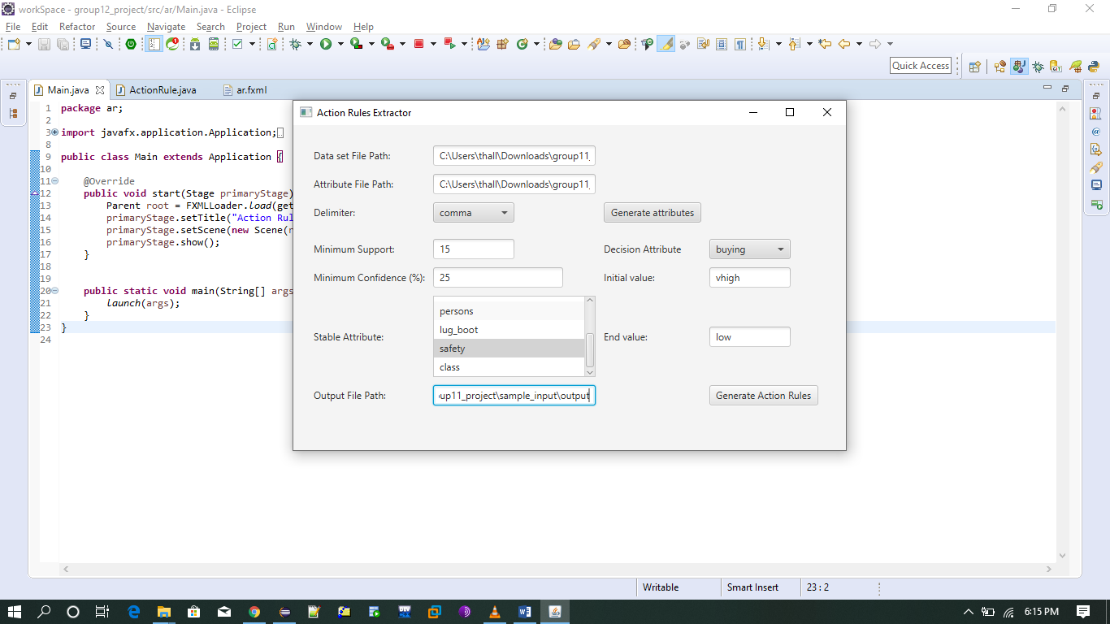
Graphical User Interface (e.g.,) Car Evaluation Data

Slide 6
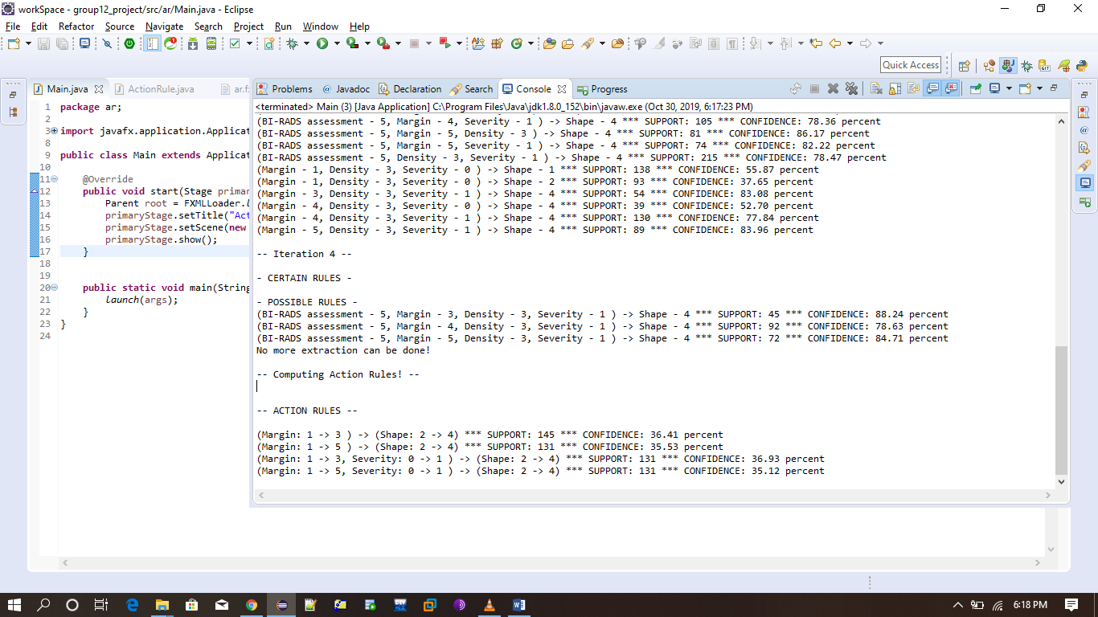
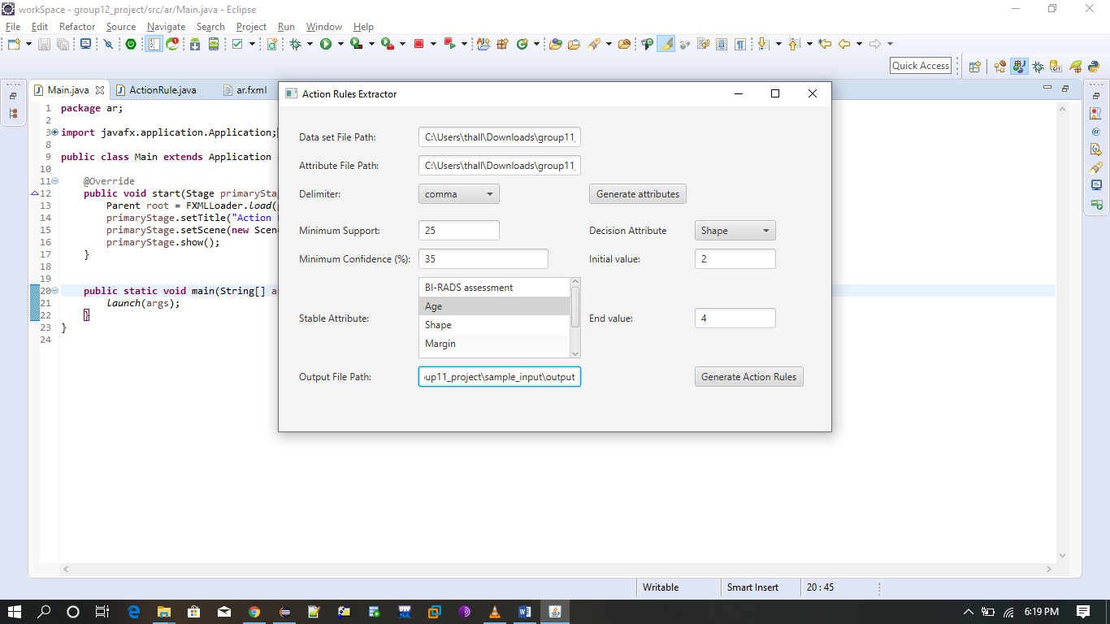
Graphical User Interface (e.g.,) Mammographic Data

